Slide 1

CC 141 Discrete Structures Department of Computer Science School of Systems and Technology University of Management and Technology Lahore, Pakistan

Slide 2
Section 2.3 Functions

Slide 3
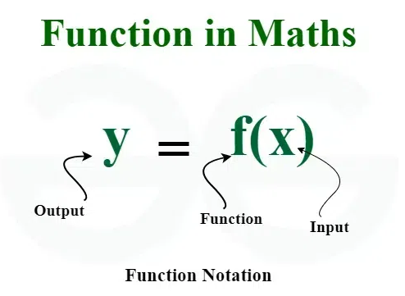
Application of Functions
Functions find their application in various fields like:
Computational complexity of algorithms,
Counting objects,
Study of sequences and strings
Modeling Real-world Relationships
Cryptography
Artificial intelligence

Slide 4
FUNCTIONS
A function f from a set X to a set Y is a relationship between elements of X and elements of Y such that each element of X is related to a unique element of Y, and is denoted f : X →Y.
The set X is called the domain of f and Y is called the co-domain of f.
Functions are sometimes also called mappings and transformations.

Slide 5
REMARK
The unique element y of Y that is related to x by f is denoted f(x) and is called
the value of f at x,
or
the image of x under f

Slide 6
ARROW DIAGRAM OF A FUNCTION
The definition of a function implies that the arrow diagram for a function f has the following two properties:
1. Every element of X has an arrow coming out of it
2. No two elements of X has two arrows coming out of it that point to two different elements of Y.

Slide 7
EXAMPLE
Let X = {a, b, c} and Y = {1, 2, 3, 4}.
Define a function f from X to Y by the arrow diagram.
f(a) = 2, f(b) = 4,and f(c) = 2 OR
image of a = 2, image of b = 4, image of c = 2

Slide 8
NONFUNCTIONS
X = {2, 4, 5} to Y = {1, 2, 4, 6}
NOT A FUNCTION NOT A FUNCTION

Slide 9
RANGE OF A FUNCTION
Let f: X→Y. The range of f consists of those elements of Y that are images of elements of X.
Symbolically:
Range of f
= {y ∈Y | y = f(x), for some x ∈ X}

Slide 10
REMARKS
The range of a function f is always a subset of the co-domain of f.
The range of f: X →Y is also called the image of X under f.
When y = f(x), then x is called the pre-image of y.
The set of all elements of X, that are related to some y ∈Y is called the inverse image of y.

Slide 11
EXERCISE
Determine the range of the functions f, g, h from
X = {2, 4, 5} to Y = {1, 2, 4, 6} defined as:
2. g = { (2, 6), (4, 2), (5,1) }
3. h(2) = 4, h(4) = 4, h(5) = 1

Slide 12
SOLUTION
Range of f = {1, 6}
Range of g = {1, 2, 6}
Range of h = {1, 4}

Slide 13
GRAPH OF A FUNCTION
Let f be a real-valued function of a real variable. i.e. f: R →R. The graph of f is the set of all points (x, y) in the Cartesian coordinate plane with the property that x is in the domain of f and y = f(x).

Slide 14
EXAMPLE
We have the function
y = x² From set of real numbers to set of real numbers.

Slide 15
VERTICAL LINE TEST FOR THE GRAPH OF A FUNCTION
For a graph to be the graph of a function, any given vertical line in its domain intersects the graph in at most one point.
For y = x²
So, it’s the graph of a function.

Slide 16
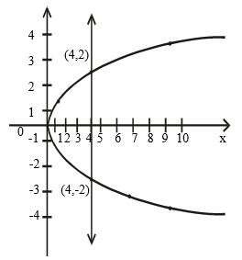
EXERCISE
Define a binary relation P from R to R as follows:
for all real numbers x and y (x, y) ∈ P ⇔ x = y²
Is P a function?
The graph of the relation x = y² is shown below
x | Y
9 | -3
4 | -2
1 | -1
0 | 0
1 | 1
4 | 2
9 | 3
This is not a graph of a function.

Slide 17
EXERCISE
Find all functions from X = { a, b } to Y = { u, v }
SOLUTION

Slide 18
Find all functions from X = { a, b } to Y = { u, v }

Slide 19
EXERCISE
Find four binary relations from X = { a, b }to Y = { u, v } that are not functions.
SOLUTION

Slide 20
EXERCISE
How many functions are there from a set with three elements to a set with four elements?
SOLUTION
Let X = {x₁, x₂, x₃} and
Y = {y₁, y₂, y₃, y₄}
x₁ may be related to any of the four elements y₁, y₂, y₃, y₄ of Y.
x₁ has four possibilities.
x₂ has four possibilities.
x₃ has four possibilities.
Total number of function = 4 x 4 x 4 = 64

Slide 21
EXERCISE
Suppose A is a set with m elements and B is a set with n elements.
How many functions are there from A to B?
SOLUTION:
Number of functions from
A to B = n.n.n. … .n (m times)
= n ^{m}

Slide 22
FUNCTIONS NOT WELL DEFINED
Determine whether f is a function from Z to R if

Slide 23
SOLUTION
f is NOT well defined since each integer n has two images +n and –n.
f is NOT well defined since f(2) and f(-2) are not defined.
f is NOT defined for n < 0 since f then results in imaginary values (not real).
f is well defined because each integer has unique (one and only one) image in R under f.

Slide 24
EXERCISE
Student B tries to define a function h : Q → Q by the rule.
for all integers m and n with n ≠ 0
Students C claims that h is not well defined. Justify Student C’s claim.

Slide 25
SOLUTION
The function h is well defined if each rational number has a unique (one and only one) image.
Hence an element of Q has more than one images under h. Accordingly h is not well defined.
Hence, an element of ‘h’ has more than two images so not a function.

Slide 26
REMARK
Mathematical Formulation of Function’s Properties:
A function f: X → Y is well defined iff
∀ x₁, x₂ ∈ X,
if x₁ = x₂ then f(x₁) = f(x₂)
Means an element can not have two images. Rephrase the properties of function.

Slide 27
Types of Functions
Injective or ONE-TO-ONE Function
Surjective or ON-TO Function
Bijective Function
Identity Function
Constant Function

Slide 28
ONE-TO-ONE FUNCTION / INJECTIVE FUNCTION
Let f: X → Y be a function. f is injective or one-to-one if, and only if, ∀ x₁, x₂ ∈ X, if x₁ ≠ x₂ then f(x₁) ≠ f(x₂).
That is, f is one-to-one if it maps distinct points of the domain into the distinct points of the co-domain.

Slide 29
FUNCTION NOT ONE-TO-ONE
A function f: X →Y is not one-to-one iff there exist elements x₁ and x₂ such that x₁ ≠ x₂ but f(x₁) = f(x₂).
That is, if distinct elements x₁ and x₂ can found in domain of f then they have the same function value.

Slide 30
EXAMPLE
Which of the arrow diagrams define one-to-one functions?
f is one-to-one function
f is NOT one-to-one function

Slide 31


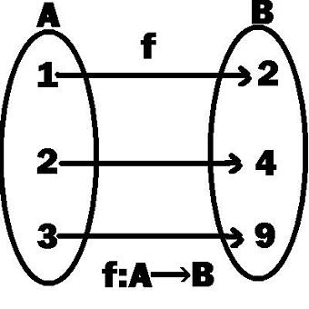
EXAMPLE
Which of the following function is injective (one-to-one) ?
f: N→N, f(x) = 5x
f: Z⁺→Z⁺, f(x)=x²
f: R→R, f(x)=x²
since (-x)² = (x)²

Slide 32
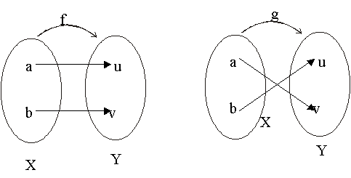
EXERCISE
Find all one-to-one functions from X = { a, b } to Y = { u, v }
SOLUTION:
There are two one-to-one functions from X to Y defined by the arrow diagrams.
We have only two one-to-one functions.

Slide 33
EXERCISE
How many one-to-one functions are there from a set with three elements to a set with four elements.
SOLUTION
Let X = { x₁, x₂, x₃} and Y = { y₁, y₂, y₃, y₄ }
x₁ may be mapped to any of the 4 elements of Y. Then x₂ may be mapped to any of the remaining 3 elements of Y & finally x₃ may be mapped to any of the remaining 2 elements of Y.
Hence, total no. of one-to-one functions from X to Y are
4 × 3 × 2 = 24

Slide 34
EXERCISE
How many one-to-one functions are there from a set with three elements to a set with two elements.
SOLUTION
Let X = {x₁, x₂, x₃} and Y = {y₁, y₂}
Two elements in X could be mapped to the two elements in Y separately. But there is no new element in Y to which the third element in X could be mapped. Accordingly there is no one-to-one function from a set with three elements to a set with two elements.

Slide 35
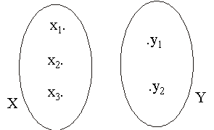
EXERCISE
How many one-to-one functions are there from a set with three elements to a set with two elements.
SOLUTION:
Let X = {x₁, x₂, x₃} and Y = {y₁, y₂}
Two elements in X could be mapped to the two elements in Y separately. But there is no new element in Y to which the third element in X could be mapped. Accordingly there is no one-to-one function from a set with three elements to a set with two elements.

Slide 36
GRAPH OF ONE-TO-ONE FUNCTION
A graph of a function f is one-to-one iff every horizontal line intersects the graph in at most one point.

Slide 37
ALTERNATIVE DEFINITION OF ONE-TO-ONE FUNCTION
Let f: X → Y be a function. f is injective or one-to-one if, and only if, ∀ x₁, x₂ ∈ X, IF x₁ ≠ x₂ THEN f(x₁) ≠ f(x₂).
The contra-positive of definition is:
If f(x₁) = f(x₂) then x₁ = x₂
If the contrapositive of the definition is also satisfied then the function is also one-to-one.

Slide 38
SURJECTIVE FUNCTION /ONTO FUNCTION
Let f: X→Y be a function. f is surjective or onto if, and only if,
∀ y ∈ Y, ∃ x ∈ X such that f(x) = y.
That is, f is onto if every element of Y is the image of some element of X.

Slide 39
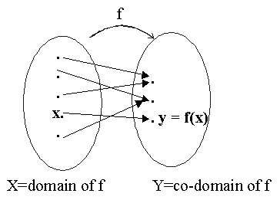
That is, f is onto if every element of its co-domain is the image of some element(s) of its domain.
i.e., co-domain of f = range of f

Slide 40
FUNCTION NOT ONTO
A function f:X→Y is not onto iff there exists y ∈ Y such that ∀ x ∈ X, f(x) ≠ y.
That is, there is some element in Y that is not the image of any element in X.

Slide 41
EXAMPLE
Which of the arrow diagrams define onto functions?

Slide 42
SOLUTION:
f is not onto because 3 ≠ f(x) for any x in X. (3 an element which is not image of any element of set X)
g is clearly onto because each element of Y equals g(x) for some x in X. (co-domain all elements are images of some elements of domain)
as
1 = g(c)
2 = g(d)
3 = g(a) = g(b)

Slide 43
GRAPH OF ONTO FUNCTION
A graph of a function f is onto iff every horizontal line intersects the graph in at least one point within the codomain.
EXAMPLE

Slide 44
EXERCISE
Let X = {1, 5, 9} and Y = {3, 4, 7}.
Define g: X →Y by specifying that
g(1) = 7, g(5) = 3, g(9) = 4
Is g one-to-one? Is g onto?

Slide 45
SOLUTION
X = {1, 5, 9} and Y = {3, 4, 7}.
g(1) = 7, g(5) = 3, g(9) = 4
g is one-to-one because each of the three elements of X are mapped to a different elements of Y by g.
g is onto as well, because each of the three elements of co-domain Y of g is the image of some element of the domain of g.
3 = g(5), 4 = g(9), 7 = g(1)

Slide 46
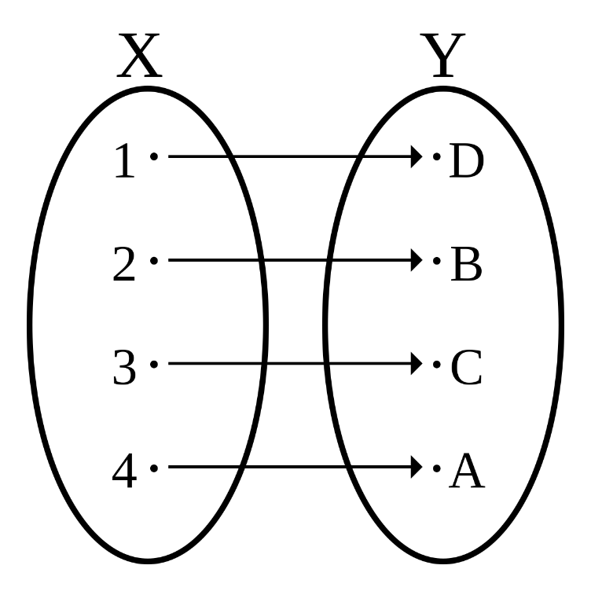
BIJECTIVE FUNCTION
A function f: X→Y that is both one-to-one (injective) and onto (surjective) is called a bijective function or a one-to-one correspondence.

Slide 47
EXAMPLE
The function f: X→Y defined by the arrow diagram is both one-to-one and onto; hence a bijective function.

Slide 48
GRAPH OF BIJECTIVE FUNCTION
A graph of a function f is bijective iff every horizontal line intersects the graph at exactly one point.

Slide 49
IDENTITY FUNCTION ON A SET
Given a set X, define a function i_{x} from X to X by
i_{x}(x) = x from all x ∈ X.
The function i_{x} is called the identity function on X because it sends each element of X mapped to itself.

Slide 50
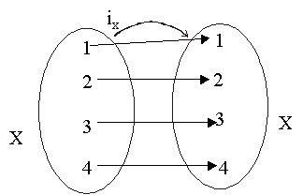
EXAMPLE
Let X = {1, 2, 3, 4}. The identity function i_{x} on X is represented by the arrow diagram.

Slide 51
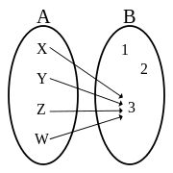
CONSTANT FUNCTION ON A SET
A function f:X→Y is constant function if it maps (sends) all elements of X to one element of Y i.e.
x ∈ X, f(x) = c for some c ∈ Y.
The constant function is one-to-one iff its domain is a singleton.
A constant function is onto iff its co-domain is a singleton.

Slide 52
INVERSE & COMPOSITIONS OF FUNCTIONS

Slide 53
EQUALITY OF FUNCTIONS
Suppose f and g are functions from X to Y. Then f equals g, written f = g, if, and only if,
f(x) = g(x) for all x ∈ X
i.e.
image of x under f = image of x under g
Note:
For functions to be equal, their domain and co-domain must be the same. If domain and co-domain are not equal then their functions equality is not possible.

Slide 54
EXAMPLE
Define f: R →R and g: R→R by formulas:
f(x) = |x| for all x ∈ R
g(x) = for all x ∈ R
Since the absolute value of a real number equals to square root of its square.
i.e., |x| = for all x ∈ R
Therefore f(x) = g(x) for all x ∈ R

Slide 55
EXERCISE
Define functions f and g from R to R by formulas:
f(x) = 2x and
for all x ∈ R.
Show that
f = g

Slide 56
SOLUTION
Accordingly f = g

Slide 57
INVERSE OF A FUNCTION
Inverse of a function may not be a function.

Slide 58
INVERSE OF INJECTIVE FUNCTION
Inverse of Injective function may not be a function.

Slide 59
INVERSE OF SURJECTIVE FUNCTION
Inverse of Surjective function may not be a function.

Slide 60
INVERSE OF BIJECTIVE FUNCTION
Note: Inverse of a Bijective function will always be a function.

Slide 61
INVERSE FUNCTION
Suppose f: X→Y is a Bijective function. Then the inverse function f⁻¹: Y→X is defined as:
f⁻¹(y) = x ⇔ y = f(x) ∀ y ∈ Y
That is, f⁻¹ sends each element of Y back to the element of X that it came from under f.

Slide 62
ARROW DIAGRAM

Slide 63
REMARK
A function whose inverse function exists is called an invertible function.
Only Bijective functions are invertible functions.

Slide 64
INVERSE FUNCTION FROM AN ARROW DIAGRAM
Let the bijection f:X→Y be defined by the arrow diagram.
The inverse function f⁻¹:Y→X is represented below by the arrow diagram.

Slide 65
WORKING RULE TO FIND INVERSE FUNCTION
First we write the function f(x) and solve f(x) = y for x (after putting the value of f(x)).
Then we write f⁻¹ (y) = Right hand side of our equation.

Slide 66
EXAMPLE
Let a function f be defined on a set of real numbers as
for all real numbers x ≠1.
Find the inverse function f⁻¹

Slide 67
Inverse function of f
The given function f is defined by the rule
⇒ x + 1 = y (x-1)
⇒ x + 1 = yx-y
⇒ y + 1 = yx-x
⇒ y + 1 = x(y-1)
⇒
Hence f⁻¹(y) =

Slide 68
COMPOSITION OF FUNCTIONS
Note:
Composition of function is always a function.
The condition to apply composition of function is 1st function range is 2nd function domain’s subset.

Slide 69
COMPOSITION OF FUNCTIONS
Let f: X →Y′ and g: Y →Z be functions with the property that the range of f is a subset of the domain of g i.e. f(X) ⊆ Y.
Define a new function gof: X →Z as follows:
(gof)(x) = g(f(x)) for all x ∈ X
The function gof is called the composition of f and g.

Slide 70
COMPOSITION OF FUNCTIONS DEFINED BY ARROW DIAGRAMS
Let
X = {1, 2, 3} and Y′= {a, b, c, d}
Y = {a, b, c, d, e} and Z = {x, y, z}.
Define functions
f: X→Y′ and g: Y →Z
by the arrow diagrams:

Slide 72
EXERCISE
Let A = {1, 2, 3, 4, 5} and we define functions f: A →A and then g: A→A :
f(1)=3, f(2)=5, f(3)=3, f(4)=1, f(5)=2
g(1)=4, g(2)=1, g(3)=1, g(4)=2, g(5)=3
Find the composition functions fog and gof.

Slide 73
SOLUTION
We have the definition of the composition of functions and compute:
f(1)=3, f(2)=5, f(3)=3, f(4)=1, f(5)=2
g(1)=4, g(2)=1, g(3)=1, g(4)=2, g(5)=3
(fog) (1) = f(g(1)) = f(4) = 1
(fog) (2) = f(g(2)) = f(1) = 3
(fog) (3) = f(g(3)) = f(1) = 3
(fog) (4) = f(g(4)) = f(2) = 5
(fog) (5) = f(g(5)) = f(3) = 3

Slide 74
Also
(gof) (1) = g(f(1)) = g(3) = 1
(gof) (2) = g(f(2)) = g(5) = 3
(gof) (3) = g(f(3)) = g(3) = 1
(gof) (4) = g(f(4)) = g(1) = 4
(gof) (5) = g(f(5)) = g(2) = 1
REMARK: The functions fog and gof are not equal.

Slide 75
COMPOSITION OF FUNCTIONS DEFINED BY FORMULAS
Let f: Z →Z and g: Z → Z be defined by
f(n) = n+1 for n∈Z
and g(n) = n² for n∈Z
a. Find the compositions gof and fog.
b. Is gof = fog?

Slide 76
SOLUTION
By definition of the composition of functions
(gof) (n) = g(f(n))
= g(n+1) (Since f(n) = n+1)
= (n+1)² (Since g(n) = n²)
(gof) (n) = (n+1)² for all n ∈Z and

Slide 77
(fog) (n) = f(g(n))
(By definition of composition of function)
= f(n²) (Since g(n) = n²)
= n²+1 (Since f(n) = n+1)
(fog) (n) = n²+1 for all n ∈Z

Slide 78
Is gof = fog?
In this case,
For n = 1
(gof)(1) = g(f(1))
= g(1 + 1) (Since f(n) = n+1)
= (1 + 1) ² (Since g(n) = n²)
= 4 where as
(fog)(1) = f(g(1))=1² + 1 = 2
Thus fog ≠ gof

Slide 79
REMARK
The composition of functions is not a commutative operation.

Slide 80
OPERATIONS ON FUNCTIONS
SUM OF FUNCTIONS
DIFFERENCE OF FUNCTIONS
PRODUCT OF FUNCTIONS
QUOTIENT OF FUNCTIONS

Slide 81
SUM OF FUNCTIONS
Let f and g be real valued functions with the same domain X.
That is f: X → R and g: X → R.
The sum of f and g denoted f + g is a real valued function with the same domain X
i.e. f+g: X →R defined by
(f+g)(x) = f(x) + g(x) ∀ x ∈ X

Slide 82
EXAMPLE
Let f(x) = x² + 1 and g(x) = x + 2 defines functions f and g from R to R.
Then
(f+g) (x) = f(x) + g(x)
= (x² + 1) + (x + 2)
= x² + x + 3 ∀ x ∈ R
which defines the sum functions f+g: X →R

Slide 83
DIFFERENCE OF FUNCTIONS
Let f: X →R and g:X →R be real valued functions. The difference of f and g denoted by f-g which is a function from X to R defined by:
(f-g)(x) = f(x) - g(x) ∀ x ∈ X

Slide 84
EXAMPLE
Let f(x) = x² + 1 and g(x) = x + 2 define functions f and g from R to R.
Then
(f-g) (x) = f(x) - g(x)
= (x² + 1) - (x + 2)
= x² - x – 1 ∀ x ∈ R
which defines the difference function f-g: X →R

Slide 85
PRODUCT OF FUNCTIONS
Let f: X →R and g: X →R be real valued functions. The product of f and g denoted f.g or simply fg is a function from X to R defined by:
(f . g)(x) = f(x) . g(x) ∀ x ∈ X

Slide 86
EXAMPLE
Let f(x) = x² + 1 and g(x) = x + 2 define functions f and g from R to R.
Then
(f . g) (x) = f(x) . g(x)
= (x² + 1) . (x + 2)
= x³ + 2x² + x + 2 ∀ x ∈ R
which defines the product function f . g: X →R

Slide 87
QUOTIENT OF FUNCTIONS
Let f: X→R and g: X →R be real valued functions. The quotient of f by g denoted is a function from X to R defined by:

Slide 88
EXAMPLE
Let f(x) = x² + 1 and g(x) = x + 2 defines functions f and g from R to R.
Then
which defines the quotient function : X →R.

Slide 89
SCALAR MULTIPLICATION OF FUNCTIONS
Let f: X →R be a real valued function and c is a non-zero number.
Then the scalar multiplication of f is a function c.f: R →R defined by
(c.f)(x) = c.f (x) ∀ x ∈ X

Slide 90
EXAMPLE
Let f(x) = x² + 1 and g(x) = x + 2 define functions f and g from R to R.
Then
(3f-2g) (x) = (3f)(x) – (2g)(x)
= 3. f(x) – 2. g(x)
= 3(x² + 1) - 2(x + 2)
= 3x² - 2x – 1 ∀ x ∈ X

Slide 91

Summary
The topics we covered:
Functions
Domain, Range
Types of Functions
Graphs of functions
Line Tests of Functions
Inverse of Function
Composition of Function
Operations of Functions
Practice Questions

